Slide 1
Assignment for Chapter 3
Task: Make FIVE arguments from the given clues.
Indicate:
Premises (major/minor premises or observations)
Conclusion:
Assumption:
Type of argument: (out of 5 deductive and 6 inductive patterns)
Link to submit:
https://forms.gle/dvAu1ZcD6uN7h9gV6
Notes:
Instructions: Delete all the lesson slides, keep only the assignment slides and submit your file to the link.

Slide 2
Group 7:
1. Nguyễn Ngọc Mỹ Phương -BEBEIU22114
2. Phạm Thái Nhật Thanh-BEBEIU22133
3. Nguyễn Thị Như Quỳnh-BEBEIU22122
4. Đặng Thị Trúc Thắm - BEBEIU22132
5. Đặng Trần Minh Châu - BEBEIU22019
6. Nguyễn Ngọc Phương Thảo - BEBEIU22135
7. Lê Đức Toản - EEEEIU22065
8. Đỗ Minh Duy - ITITSB22029

Slide 3
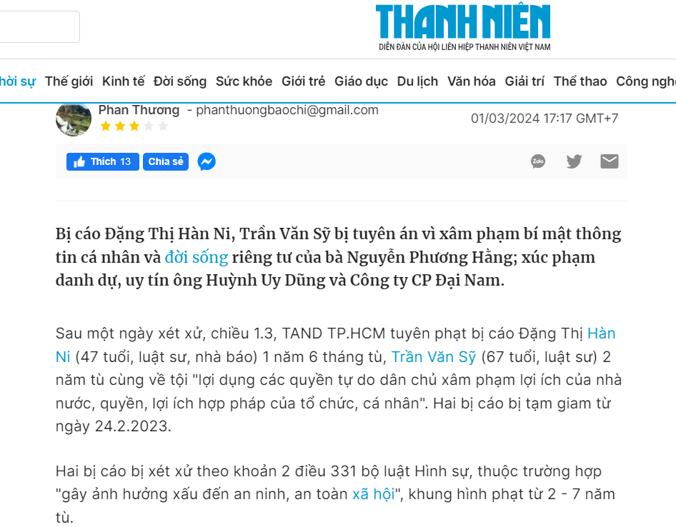
Task 1: Make an argument based on the clue
Premise + type:
Premise 1: Thi Han Ni (47 years old, lawyer, journalist) was sentenced to 1 year and 6 months in prison, while Tran Van Sy (67 years old, lawyer) was sentenced to 2 years in prison on the charge of "abusing democratic freedoms to infringe upon the interests of the state, the legitimate rights and interests of organizations and individuals."
Premise 2: The two defendants were tried under Clause 2, Article 331 of the Penal Code, with a sentence range of 2 - 7 years in jail for "negatively affecting social security and safety".
Conclusion:
Defendants Dang Thi Han Ni and Tran Van Sy have been convicted.
Assumption:
Defendants Dang Thi Han Ni and Tran Van Sy were convicted for violating Ms. Nguyen Phuong Hang's secrecy and privacy, as well as insulting Mr. Huynh Uy Dung's honor and character and the Dai Nam Joint Stock Company.
Type of argument: Deductive

Slide 4
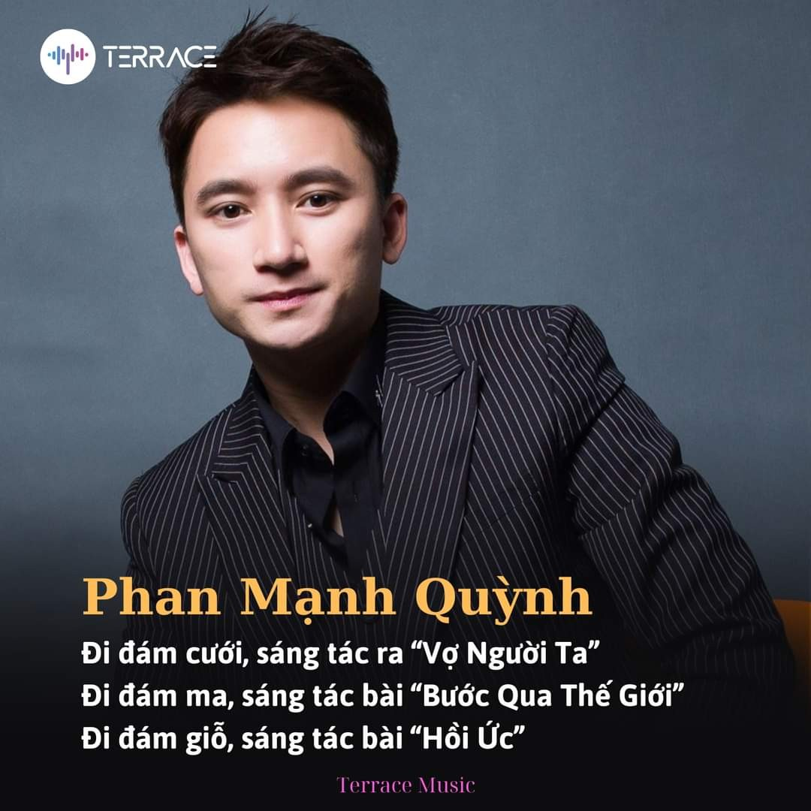
Task 2: Make an argument based on the clue
Premise + type:
Premise 1: go wedding => composed “Vợ người ta” (specific premise)
Premise 2: attend a funeral => composed “Bước qua thế giới” (specific premise)
Premise 3: go to the death anniversary => composed “Hồi ức” (specific premise)
Conclusion: The given premises imply that there is a relationship between certain events and the compositions that result from them. In each example, the music appears to be a representation of the feelings and experiences surrounding the occurrence. This connection suggests that compositions can be used to analyze and reflect on key life events.
Assumption: Based on the conclusion, it is reasonable to believe that the rituals Phan Manh Quynh attends have a significant impact on his emotional well-being. His ability to express his feelings through music demonstrates his aptitude as a composer. Observing the ceremonies he attends can provide insight into the spectrum of emotions he feels and the types of songs he may produce in the future.
Type of argument: Inductive.

Slide 5
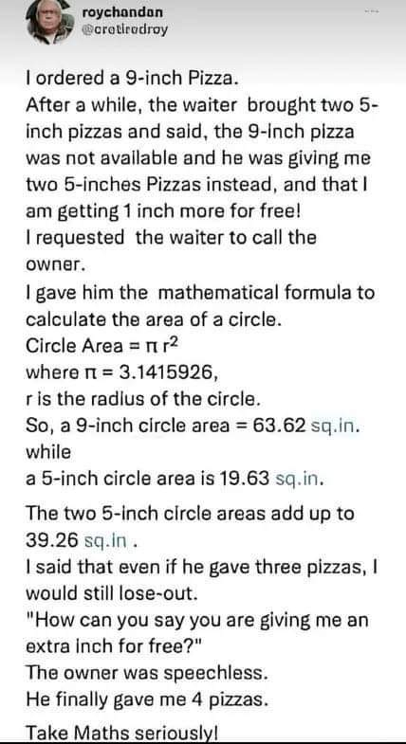
Task 3: Make an argument based on the clue
Premise + type: (factual)
Premise 1: The customer ordered a 9-inch pizza.
Premise 2: The waiter delivered two 5-inch pizzas.
Conclusion:
The waiter claims the customer gets an extra inch of pizza.
Assumption:
Area of a 9-inch pizza: π * (9/2)^2 = 63.62 square inches
Area of a 5-inch pizza: π * (5/2)^2 = 19.63 square inches
Total area of two 5-inch pizzas: 2 * 19.63 square inches = 39.26 square inches
Two 5-inch pizzas have a total area of 39.26 square inches, which is less than the area of a single 9-inch pizza (63.62 square inches).
The waiter assumes that adding the diameters of the pizzas is equivalent to getting more total pizza area. The customer's point is that the waiter is wrong to assume that simply adding the diameters of the two pizzas together gives the total area. The customer successfully used math to argue his point and convince the owner to give him four pizzas instead.
Type of argument: Deductive argument

Slide 6
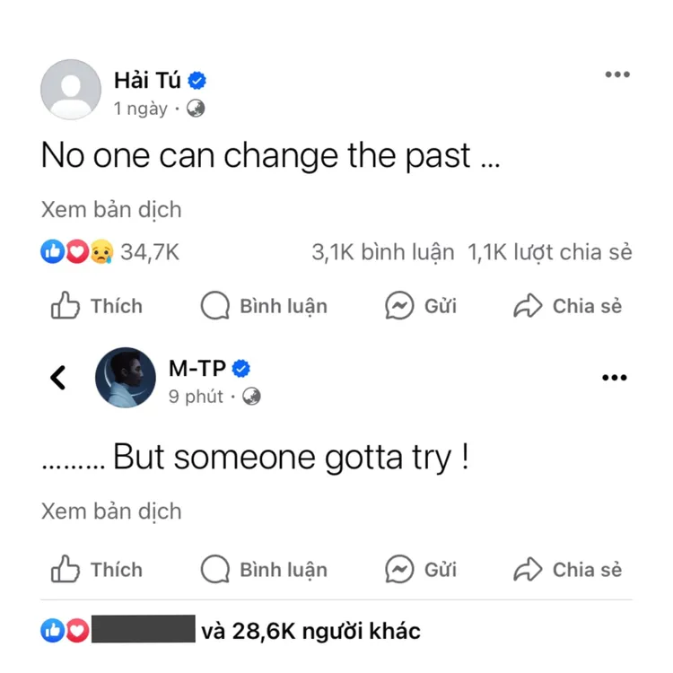
Task 4: Make an argument based on the clue
Premise + type:
Premise 1: The past is unchangeable by anyone.
Premise 2: However, someone continued trying
Conclusion: Combining the sayings of the two figures in the photo makes sense: While past can not be changed, some people continue to attempt.
Assumption: Hai Tu implies that the past cannot be changed by anyone - a fact. Then Son Tung (her reported lover) added another sentence, hinting that some individuals still attempt to change. The two statuses lead individuals to separate into two arguments.
-They both ended their relationships.
-It's a hint to prepare for Singer Son Tung's music video.
Type of argument: Predictive argument - inductive patterns

Slide 7
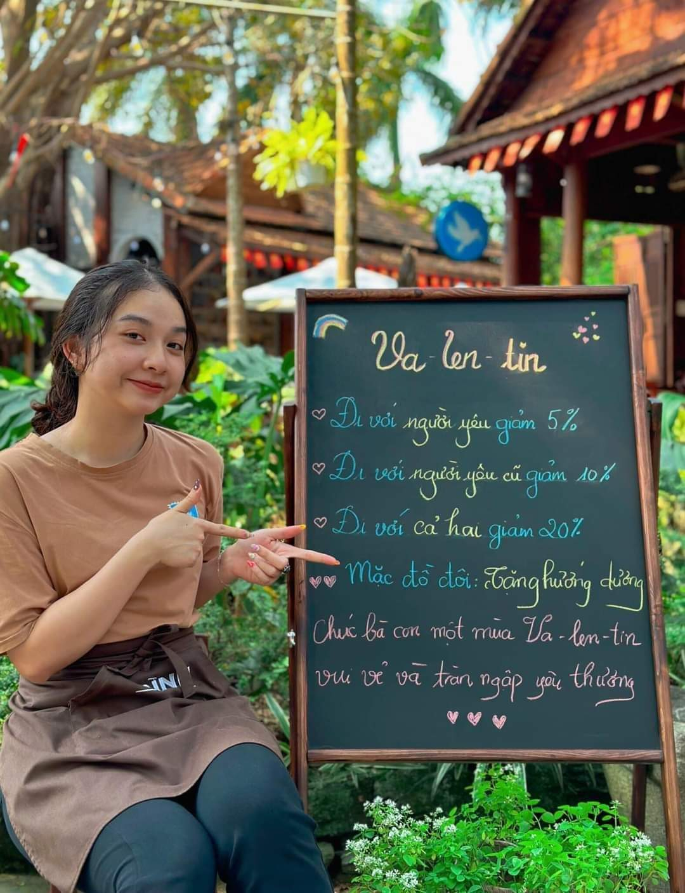
Task 5: Make an argument based on the clue
Premise + type: “Va-len-tin” is a special day for couple. ( minor premise)
-Premise 1: go with your girl/boy-friend 5% off.
-Premise 2: go with your ex-girl/boy-friends 10% off.
-Premise 3: go with both your girl/boy-friend and ex-girl/boy-friend 20% off.
-Premise 4: wear couple clothes, you will be donated sunflower seeds.
-Conclusion: This store has a unique discount system for couples on Valentine's Day. The discount rate increases depending on certain criteria; first, if you and your significant other wear matching couple shirts, second, if you visit the store with your current girlfriend, third, if you visit the store with your ex-girlfriend, and finally, if you visit the store with both your ex-girlfriend and current girlfriend together.
-Assumption: By offering discounts based on unconventional criteria like visiting with an ex-girlfriend or both an ex-girlfriend and current girlfriend together, the store may be aiming to spark conversations and interactions among customers, leading to increased foot traffic and potentially higher sales during this festive period. Overall, the assumption is that the store’s intention behind this unique discount system is to stand out from competitors, drive customer engagement, and capitalize on the romantic theme of Valentine’s Day to boost sales.
-Type of argument: deductive argument.
Notes:
https://plo.vn/mo-xe-vu-du-doan-dung-de-thi-van-bi-de-nghi-xem-xet-xu-phat-hanh-chinh-post689380.html

Slide 8
Task 6: Make an argument based on YOUR clue
Premise + type:
Premise 1: Regular physical exercise has numerous health benefits, including reducing the risk of chronic diseases.
Premise 2: Regular physical exercise improves mental health and cognitive function.
Conclusion: Therefore, incorporating regular exercise into one's lifestyle is essential for promoting mental well-beings,cognitive functioning and reducing the likelihood of developing chronic illnesses.
Assumption: I think there is a positive correlation between regular physical activity and improved health outcomes in maintaining psychological well-being and cognitive resilience.
Type of argument: Causal argument – inductive patterns

Slide 9
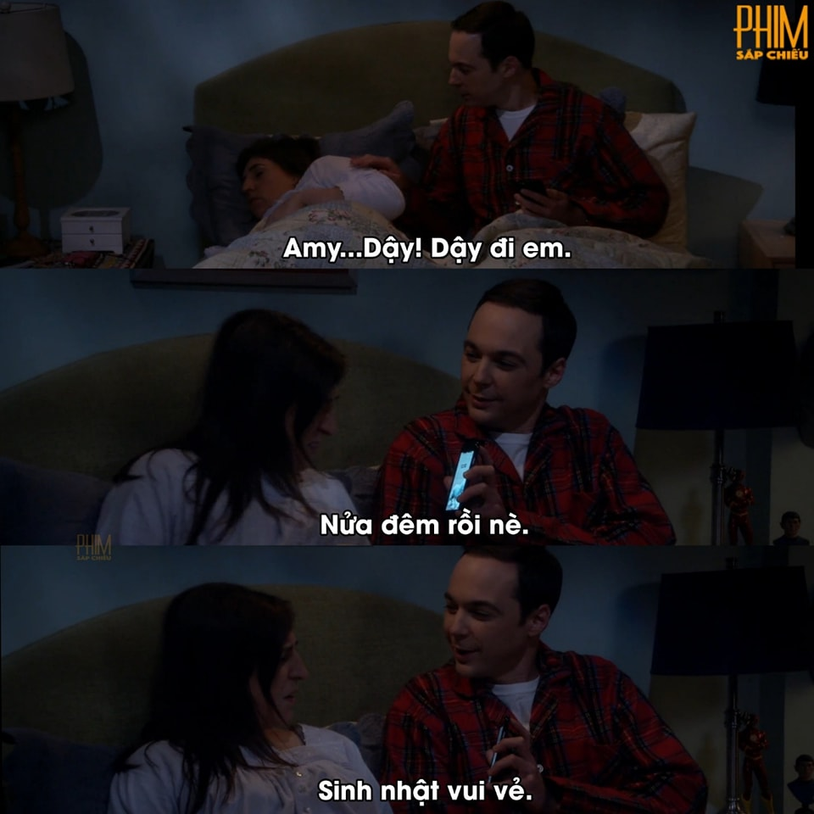
Task 6: Make an argument based on YOUR clue
-Premise 1: It is Amy’s birthday.
-Premise 2: The birthday celebration begins at midnight, once Amy falls asleep.
-Conclusion: It is logical to conclude that Sheldon wants to wake Amy up at midnight so he can congratulate Amy on her birthday.
-Assumption: when someone loves you, they want to be the first person to celebrate your birthday.
-Type of argument: Hypothetical syllogism- deductive pattern.
*Cre on pic

Slide 10

‹#›

